Slide 1

Apache Camel - Essentials
29.04.2016 Goldschmiede anderScore by Maz Rashid, maz@mazcity.de @geeky4lks

Slide 2
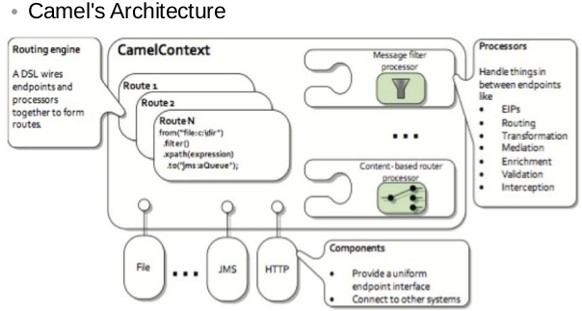
What is Apache Camel
Integration Framework
Enterprise Integration Patterns (EIP)
Routing (i.e from FTP to WS)
Payload Agnostic
Easy configuration/definition
No Container Dependency
A lot of components
Mature / Accepted integration platform

Slide 3
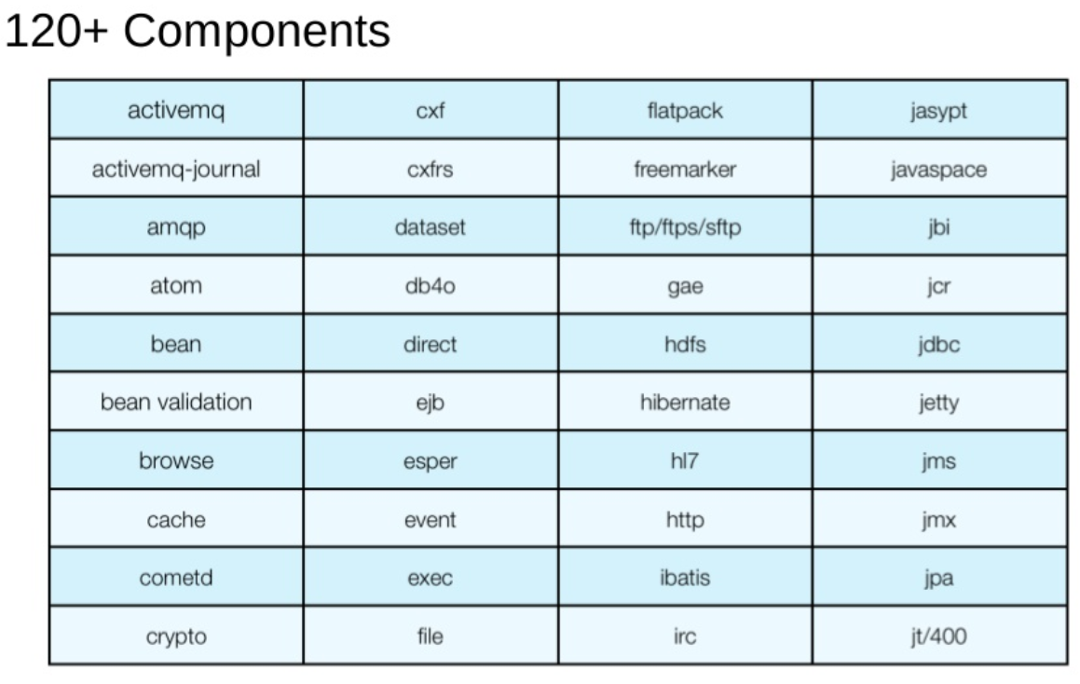
What is Apache Camel

Slide 4
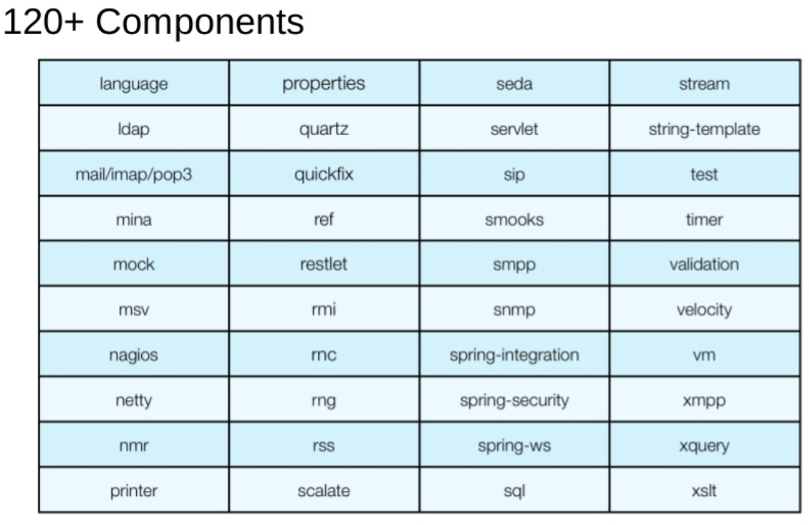
What is Apache Camel

Slide 5
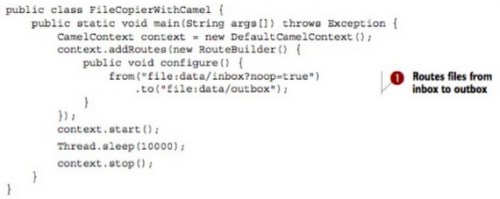
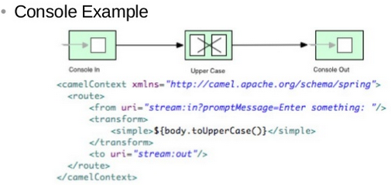
Simple Examples
That simple can a File Copier be:

Slide 6
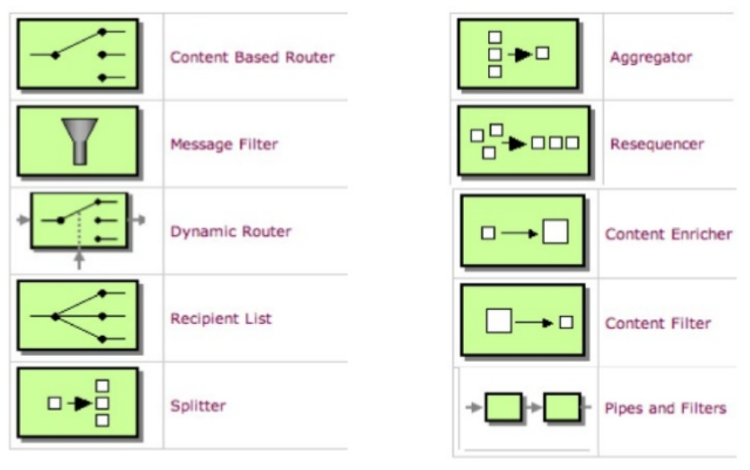
Enterprise Integration Patterns
All major EIPs are implemented:

Slide 7
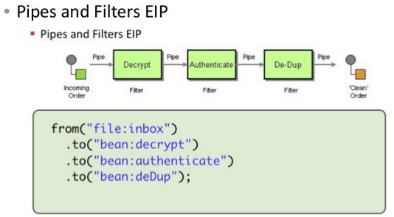
EIP: Pipes and Filters

Slide 8
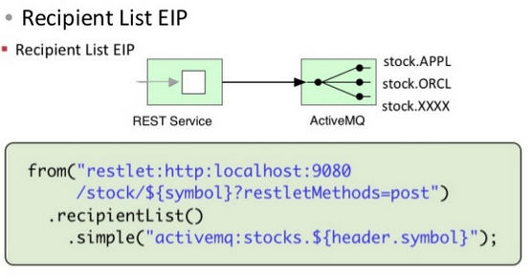
EIP: Recipient List

Slide 9
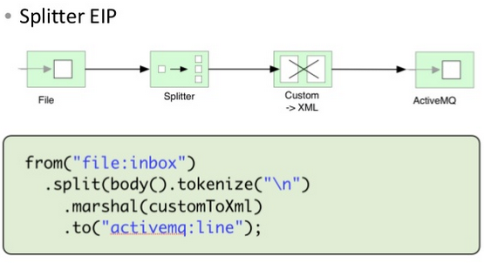
EIP: Splitter

Slide 10
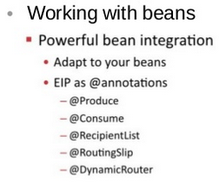
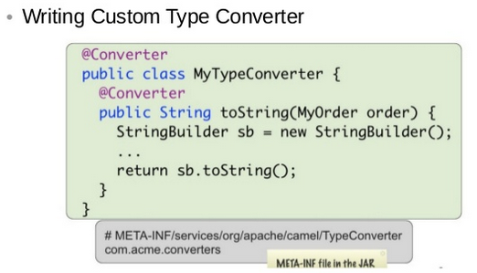
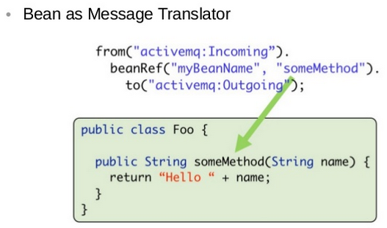
Simple Extendable

Slide 11

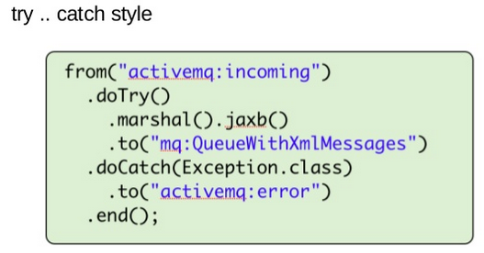
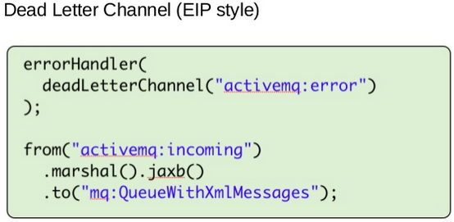
Error Handling

Slide 12
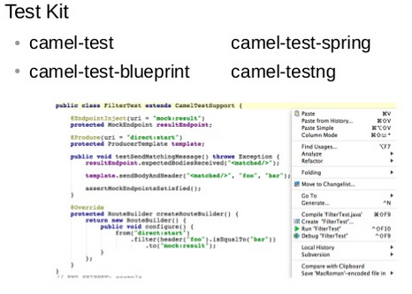
Test Support

Slide 13
Thank You, Feedback Welcome!
Maz Rashid, mazcity consulting
Senior Solution Architect, IT-Landscape Gardner Projectmanager
maz@mazcity.de @geeky4lks

